Slide 1
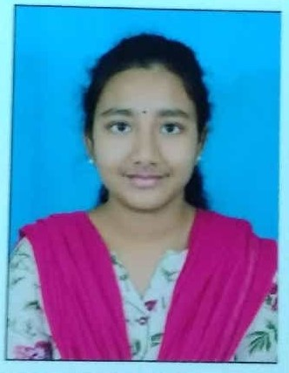
SARIPALLI DIVYA SOFTWARE ENGINEER
hhh
SUMMARY
PROFESSIONAL ACHIEVEMENTS
To obtain a post in a company where I use all knowledge to become an asset for company and where I can get a challenging environment to explore myself.
Worked in Government TV channel(Doordarshan), Hyderabad 2019.
Worked on the project “Multilevel image thresholding for segmentation using cuckoo search algorithm“ in Digital Image processing Domain.
TOOLS & TECHNOLOGY:
CAREER ACHIEVEMENTS
MySQL
Maven
Java
Jenkins
GitHub
Eclipse
Visual Studio
Awarded Elite with silver in NPTEL Online Certification on “Speaking with effectively" from IIT Kharagpur in 2018.
Participated in “Aptis Forward Thinking English Test” with A1 Grade.
PERSONAL SKILLS:
Discipline
Hard-working
Honest.
RELEVANT WORK EXPERIENCE
Worked on developing application using Spring & Hibernate, Angular, Spring boot & Microservices.
Hands-on experience in Spring MVC web as the framework developed a web application as a mini project.
Worked on Eclipse, Web Technologies, MySQL, Apache Tomcat, Visual Studio and Maven.
Displaying the information in “Smart Display Board “using Blynk server through cloud
EDUCATION:
Completed my Graduation in the stream of Electronics & Communication Engineering at AITAM, Tekkali in the year 2020 with 79.18%.

